Slide 1


Social Impact Report
2021-2022

Slide 2

“
Statement from our CEO
Our Environmental, Social and Governance (ESG) Strategy is deeply embedded in the way we do business and deliver services. We care about the impact we have on our clients, our employees, the communities we serve and our environment. As an ESG-led facilities services leader, our goal is to grow sustainably and continuously improve, acting as an exemplar for our sector by challenging ourselves to raise our performance and deliver on our promise to create Better Places, Better Lives.
2021 was yet again another busy year for our teams, who have worked tirelessly to navigate through what we hope to be the end of the COVID-19 pandemic. Above and beyond their day jobs, 88% of our colleagues have signed up to volunteer in our local communities, up from 63% last year.
Over the year, we have also donated over £35,000 to our housing association charities, an increase of £20,000 more than last year in an effort to help those most in need in these difficult times. Furthermore, we have seen a pleasing increase in the number of social housing residents employed by Just Ask, increasing to 37% and now more than 1 in 3 of our colleagues, compared with 32% last year.
2022 sees Just Ask commit further to our promise of creating Better Places, Better Lives, with the creation of our new 2023 ESG Strategy that will continue to focus our ESG efforts and actions over the next 12 months, the detail of which can be found later in this presentation.
Mark Little, CEO

Slide 3
Sustainable opportunities for the communities we impact
We believe in creating safe and sustainable communities through our social purpose, which is grounded in the Just Ask family ethos. Boosting the economy, improving the lives of our customers, and helping people fulfil their potential and contribute to their community. This approach is critical to delivering our vision of making a positive difference to people’s lives thought stainability, meeting the demands of our customers and communities, while pushing ourselves to deliver long lasting stainable goals by meeting our social and environmental challenges.
In the following pages we will outline the results of the actions we have taken to look after our Just Ask family, the communities we work with and keeping our planet sustainable.
Responsibilities
Employees
Communities
Environment
Support economic recovery
Social impact delivery
Diversity and equal rights
Customers rights and satisfaction
Stakeholder engagement
Economic value creation
Human rights
Business and ethnic compliance
Corporate governance
Employee wellbeing, health and safety
Gender Equality
Stainable training solutions
Full productive employment and decent work for all
Trust between employee and management
Ensuring safe, resilient and sustainable community’s
Outstanding environmental provisions for green spaces.
Actively employing within the community
Empowering customers with local forums
Promoting sustainable solutions to improve living environments
Take urgent action to combat climate change
Stakeholders' development agenda.
Just ask supports an ambitious climate driven goal to be zero net carbon by 2050
Working in partnership for environmental stainability

Slide 4
90%
Employees surveyed state “they enjoy working for Just Ask and would recommend working here”
Just ask continues to commit to helping colleagues reach their maximum potential in the 2021/2022 period we have:
Employees
Engaged with over 30 Housing associations and councils, supporting employment and training opportunity's to residents in social housing.
Maintained our investors in people gold status.
Engaged with DWP to support the back to work drive following the pandemic to promote economic recovery.
Delivered workplace forums influencing and driving decision making at all levels.
Continuous professional staff development .
140 Courses available on our E-learning platform, with 3 more being added every month
37%
of our workforce are residents

Slide 5
2964
volunteering hours have been pledged by our colleagues
We are proud to report robustly on our commitment to supporting the communities we operate in.
In particular:
Communities
a significant proportion of our colleagues have committed to volunteering in their communities.
our colleagues have pledged to 2964 hours in total.
We have worked closely with our housing associations to identify volunteering projects that support residents needs to make a real difference.
We supported various housing associations charities donating a total of £35,000 this year.
We have built our social impact around standability and the needs of our residents .
Ensuring safe, resilient and sustainable community’s
Outstanding environmental provisions for green spaces.
Actively employing within the community
Empowering customers with local forums
Promoting sustainable solutions to improve living environments
88%
Percentage of total workforce signed up to volunteering
£30k+
donated to housing association charities.

Slide 6





Charitable donations supporting sustainable communities
Breakfast clubs can have positive impacts on pupils' ability to concentrate, and pupils who have eaten breakfast are more prepared to learn.
Uniting the community through performance arts .Since 2008, this social housing project has earned widespread recognition, winning the Best Regeneration Project distinction at this year’s National Housing Awards..
Supporting residents by providing basic personal items such as food, hygiene and cleaning products.
Every year there is an increasingly strong demand for support to help children navigate the transition from primary to secondary schools. The evidence is clear; children need a positive transition if they are to achieve their full life potential.
This year our funding of £5,000 will supply 30 free spaces to children transitioning from primary to secondary school, hosted on site of their new school pupils will engage in fun activities that focus on social skills, resilience, self-esteem and showcasing their individuality.
Demelza offers a community hospice at home service for children and young people up to the age of 18, providing therapies, respite and end of life care in the comfort of a child’s own home across London & East Sussex.

Slide 7
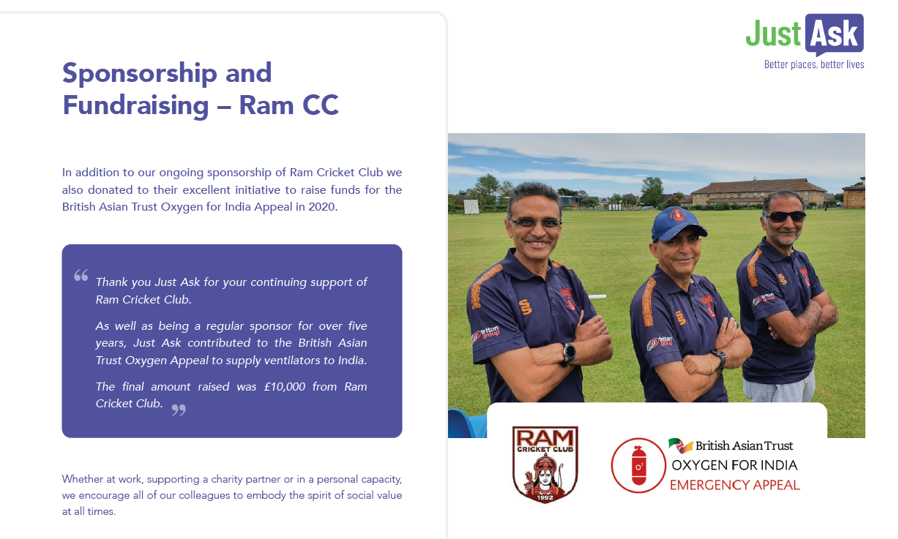
Responsibilities
Support economic recovery
Social impact delivery
Diversity and equal rights
Customers rights and satisfaction
Stakeholder engagement
Economic value creation
Human rights
Business and ethnic compliance
Corporate governance

Slide 8
87.8%
economical driving score across our fleet, advised by the Lightfoot telematics system.
Assisting with fuel saving and a CO2 reduction
At Just Ask, we are committed to managing and reducing any effects that our business model has on the environment. In the 2021/22 period we have:
Environment
Replenished our fleet with 118 new vehicles that are fitted with improved technology to minimise our impact and footprint on the environment.
Mobilised our first contract with all electric lawnmowers and hedge cutting equipment.
Continued to manage and review our waste processes to ensure so far as possible, all by-products of our operations are recycled with reputable waste recycling facilities.
Take urgent action to combat climate change
Stakeholders' development agenda.
Just ask supports an ambitious climate driven goal to be zero net carbon by 2050
Working in partnership for environmental stainability
6
Trialed fully electric/hybrid vehicles to review their suitability for our operations

Slide 9
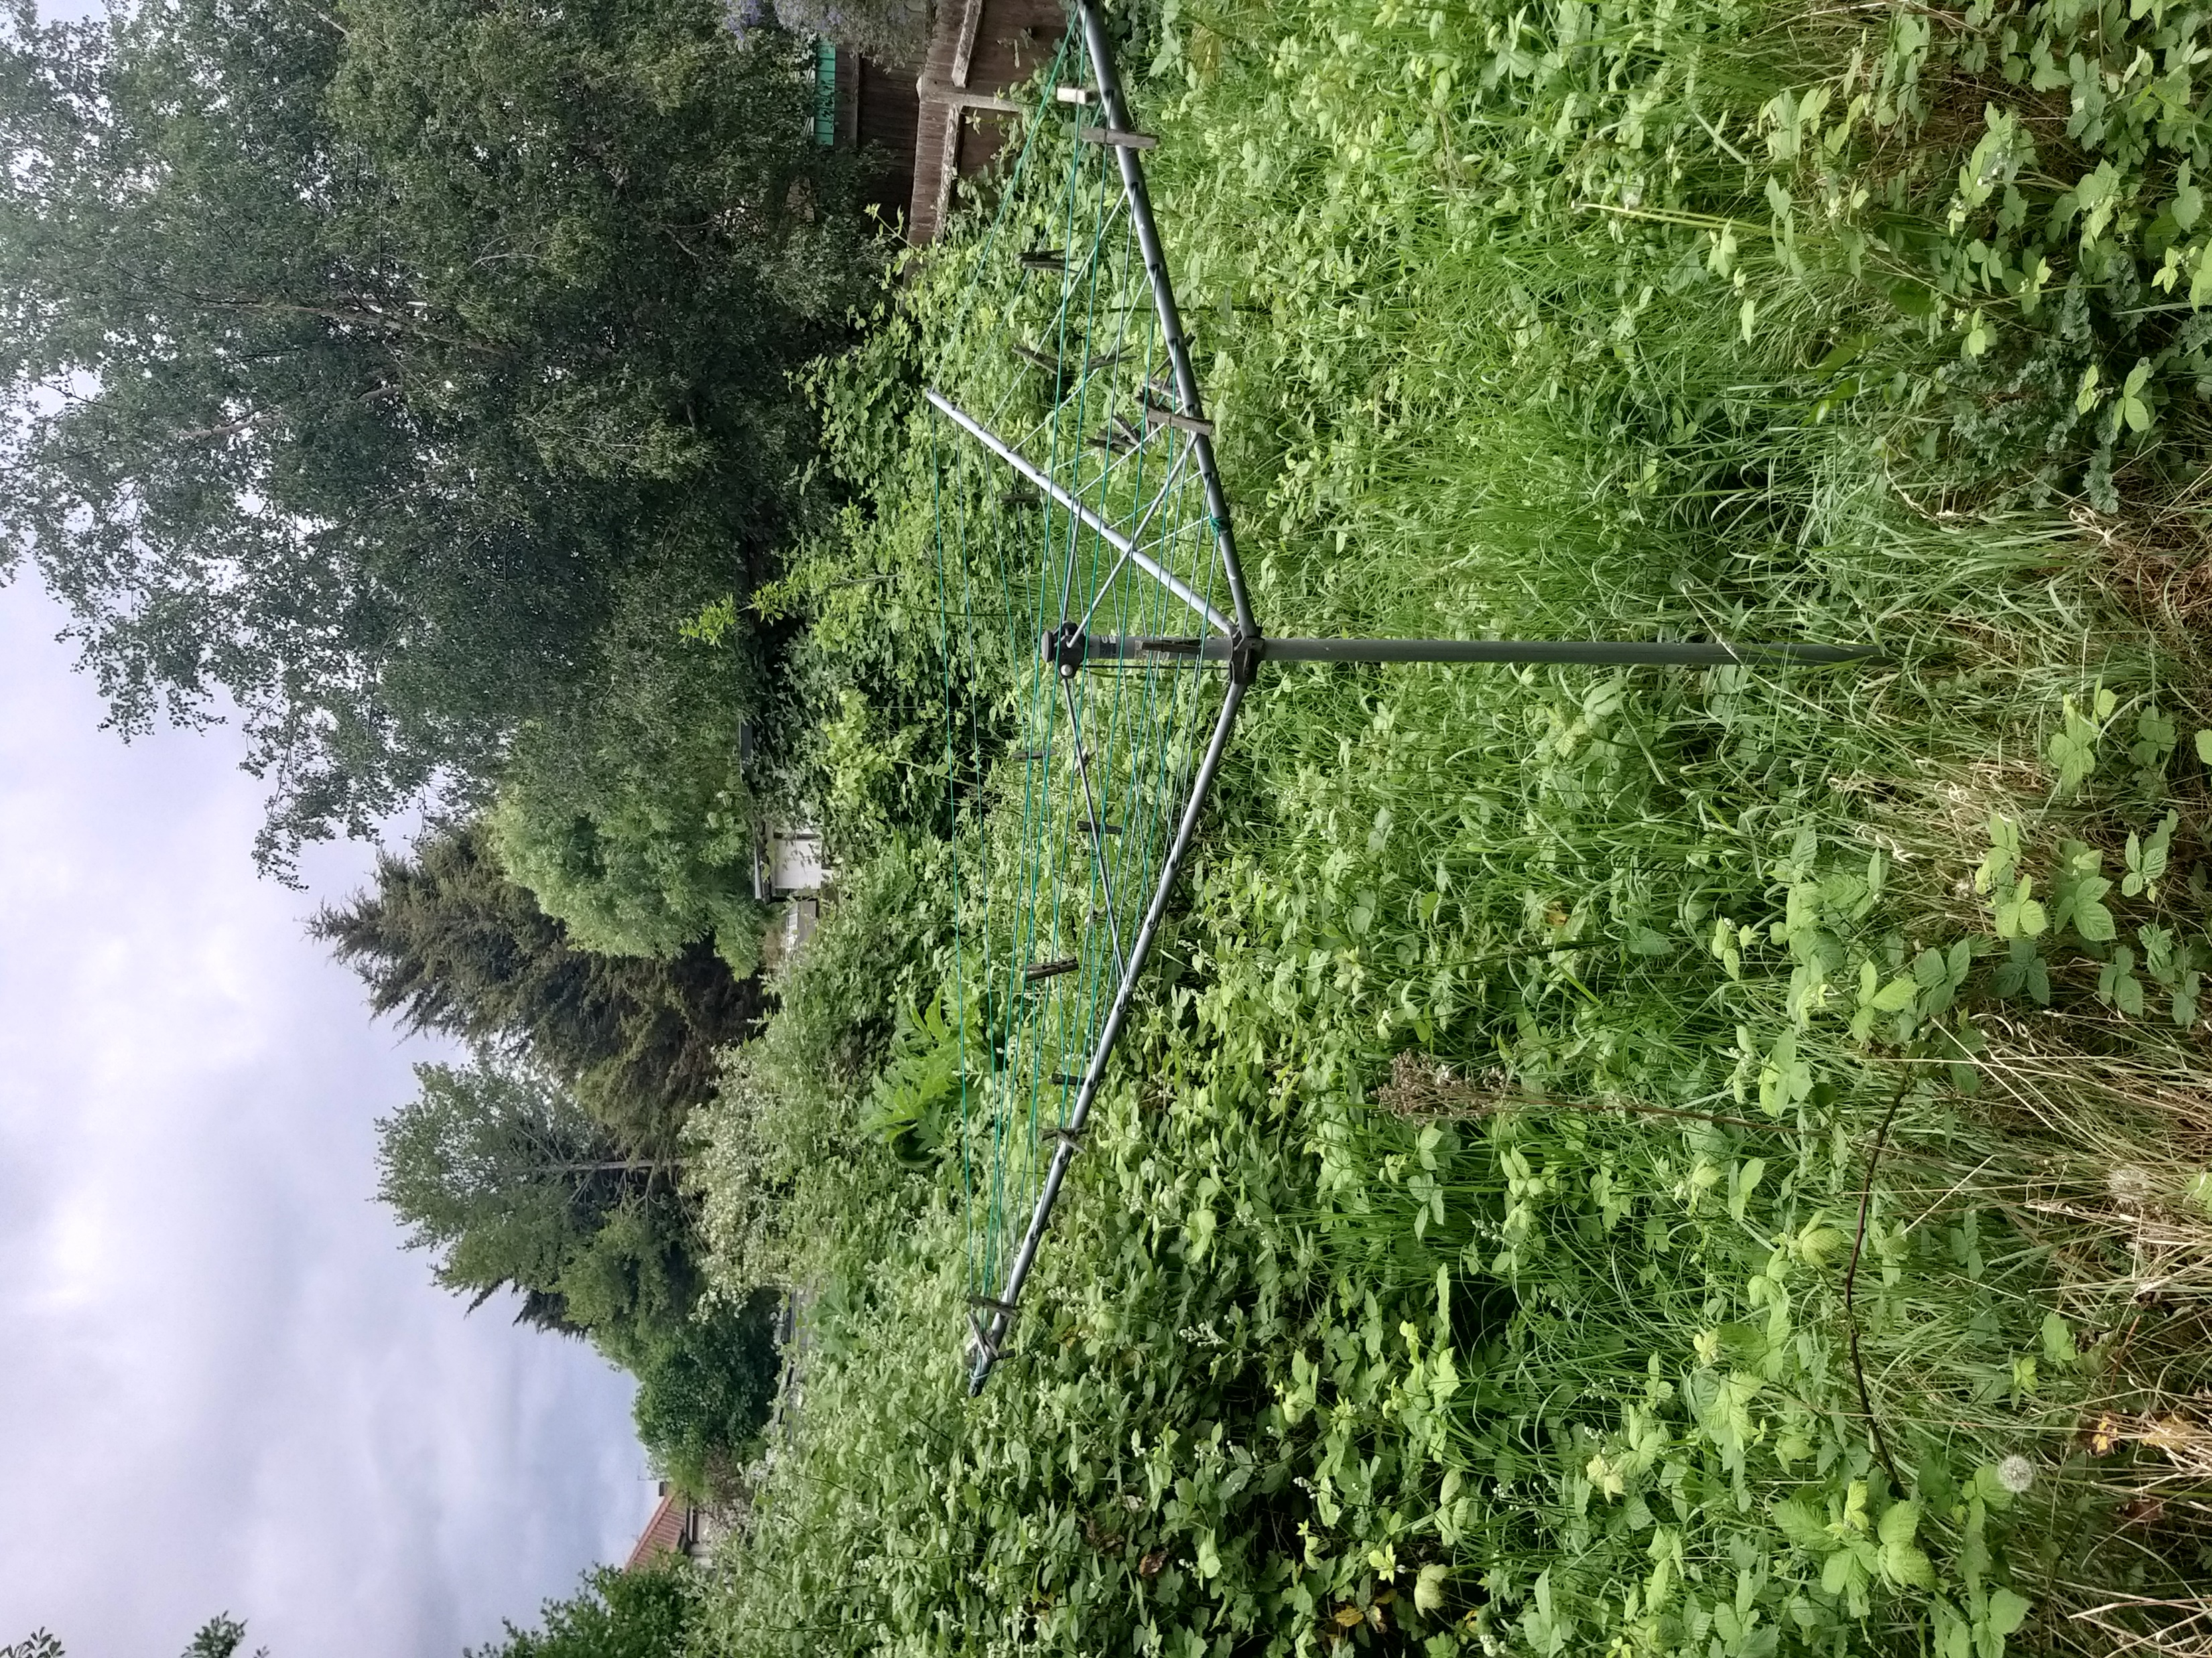
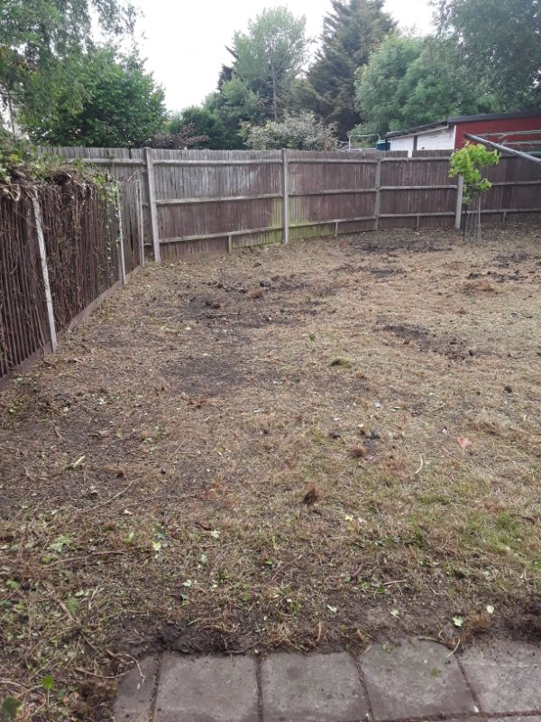
Case Study: Environmental Benefits
Jack’s Garden
Case study
Jack has a number of long-standing health issues. A couple of years ago he also suffered a stroke which left him with difficulties breathing as well as being physically weaker compared to his early years. He is trying to recover from the stroke, but the progress is very slowly.
Just Ask received a request for support. The team arrived at Jack’s property where 6 members of staff cleared the area and removed all the green wastes, leaving Jack a space that enabled him to build a new usable garden to enjoy once again.
Evidence strongly suggests that if we spend time in a green environment, then we reduce stress, improve mood and enhance our wellbeing & mental heath.

Slide 10
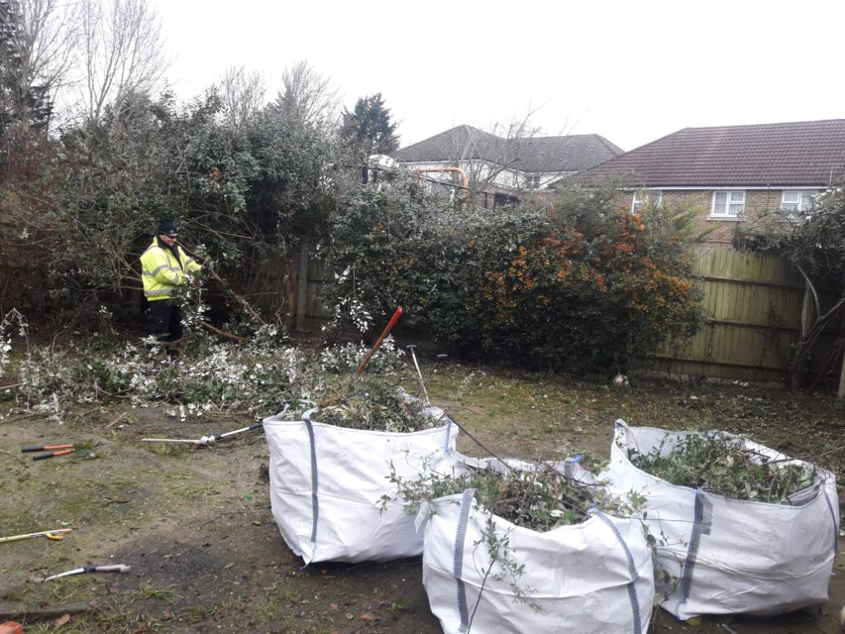
Case Study: Health and Wellbeing
Joan’s Garden
Case study
Health and wellbeing are a fundamental challenge within the housing community. We have been supporting residents through our volunteering program, giving our time to improve the environment and health and wellbeing of our residents and the community.
Joan has lived in Hampshire all her life, struggling with the upkeep of her garden due to ill health and mobility issues leading her to miss out on the company of her neighbours, who had complained about the environmental and health issues around Joan’s Garden.
Joan had not been able to use her garden for two years and very rarely left her house, with limited light coming into the property due to overgrown foliage, the property had become unnecessarily dark inside. With the Covid pandemic still very prominent for the vulnerable members of our community, who have been isolating for the past 2 years, the ability to access an outside space has never been so important.
In November, we sent a team, Joan’s Garden was quite large and very overgrown, the team cut back the overgrown areas, put in flower beds, boarders, and paved areas. As well as pruning shrubs, plants, and removing a large amount of green waste and unwanted goods from the garden.
Understanding that this was a complex situation requiring careful execution, our colleagues involved Joan in all decision making and made sure that she had the support she needed throughout the process.

Slide 11
2023 ESG Strategy – our continuing commitment to creating a sustainable tomorrow for the environment, our local communities and our partners
Environmental
Social
Governance
We are committed to our Environmental, Social and Governance Strategy
through the culture we embrace as one team.
“We care about our customers, our employees, our supply partners and the communities we serve.
Our common purpose is to make a positive local impact and, through our services, show our business to be a force for good in our world.”
Environmental
Energy Usage
Waste Pollution
Natural Resource Conservation
Evaluating any environmental risks we may face and how we manage those risks.
Social
Achieving the highest standards in delivering services that help to make “better places and better lives”
Ensuring cultural alignment with partners and suppliers, preferring to work with those who share consistent values & ethics
Supporting the Living Wage
Contributing more to our local communities
Treating people fairly, with equity and respect
Ensuring that we commit as one team to our groupwide ESG goals and the spirit of achievement, contribution and improvement
Governance
Ensuring we use accurate and transparent accounting methods
Allowing stakeholders to help us shape the business and vote on important issues
Providing assurances to our customers, our investors and our suppliers that we operate in an ethical and sustainable manner
Demonstrating to customers that our processes are robust through accurate, timely and purposeful reporting
Connecting with employees, investors and customers to share our ESG achievements and ambitions

Slide 12



Our commitments
Committing to the well being of our team, our customers and investors and that we act responsibly.
Environmental
We will support and improve our client environments.
We will ensure our fleet is performing to the highest standards.
We will reduce fuel consumption.
We will reduce energy consumption at our Head Office Locations.
We will reduce waste to landfill from our bulk waste business stream.
Social
We will maintain our industry leading group attrition rates.
We will continue to support our chosen charities.
We will actively seek to reduce unemployment.
We will commit to developing the skills of our local communities.
Governance
We will improve standards and drive continuous improvement.
We will maintain high levels of sub-contractor audits.
We will pay our suppliers on time.
We will maintain a diligent focus on Health and Safety.
We will ensure that we are acting responsibly to protect our staff, clients, stakeholders and investors.
Committing to reducing our carbon footprint with appropriate measures in place to reduce consumption.
Committing to creating opportunities within the community for people to thrive by making a meaningful difference.

Slide 13
Environmental enablers
Environmental
We will support and improve our client environments - by focusing on innovation creating more sustainable solutions, increasing productivity
and output.
We will work with our supply chain to implement the latest technological advances within our contacts.
We will search for continuous improvements to enhance the environments we support.
We will promote this through our innovation forum and disseminate our findings throughout the group.
We will ensure that our fleet is performing to the highest of standards – we will target 90% efficiency.
We will monitor monthly our driving performance via our telemetry and deliver hot topic updates to colleagues with hints and tips of responsible driving.
We will discuss weekly at an operational level our performance and guide towards continuous improvements.
We will deliver training at the onboarding stage to ensure we maximise on our positive impact.
We will reduce fuel consumption – miles per gallon (litre) – we will improve this by 10% on last year.
We will invest in new vehicles across the group to improve fuel efficiency.
We will continuously monitor and assess the viability of an electric fleet.
We will deliver training on how to drive responsibly.
We will reduce energy consumption at our head office locations.
We will review alternative gas and electric suppliers to ensure we are supported by the most environmentally friendly partners.
We will review our consumption and encourage colleagues to think about their energy consumption through campaigns.
We will review and implement appropriately more environmentally friendly lighting and heating solutions.
We will reduce waste to land fill from our bulk waste business stream – we will maintain this to under 0.01%.
We will review these statistics with our supply partners quarterly.
We will seek alternative ways of disposing of items collected and encourage recycling/upcycling.

Slide 14
Social enablers
Social
We will maintain our industry leading group attrition rates @ 31% (voluntary).
We will offer clients the opportunity to incorporate the living wage into their contracts by reviewing our methodologies and providing (where possible) alternative delivery models to mitigate any financial burden.
We will provide alternative prices on new bid activity that incorporates the living wage.
We will ensure all group companies become members for the living wage foundation.
We will invest in industry leading online training tools accessible to all colleagues with multi language capabilities that will integrate with our existing compliance systems.
We will continue to support our chosen charities – Demelza House and The Ukrainian Appeal.
We will commit to supporting our chosen charities throughout the year and offer our colleagues the opportunity to do this individually or as separate teams.
We will raise awareness across the group of our chosen charities and their fund-raising appeals through our online colleague engagement portals and our Group employee forum.
We will actively seek to reduce unemployment – 8% of those people employed will have been unemployed for more than 6 months.
We will work closely with recruitment bodies to encourage the recruitment of those individuals who have been out of work for over 6 months.
We will ensure that they are onboarded with the highest levels of training and provide mentorship and guidance where appropriate.
We will commit to developing the skills of our local communities – we will create 8 apprenticeships throughout the year.
We will review the group business and assess where the best opportunity for apprenticeships sit.
We will work with our training providers to create meaningful courses that will benefit our apprentices in their future careers.
Committing to creating opportunities within the community for people to thrive by making a meaningful difference.

Slide 15
Governance enablers
Governance
We will improve standards and drive continuous improvement.
We will continue to listen to our clients using our Net Promoter Scoring (NPS) or Comment Cards. NPS Scoring will be rolled out to the PTCS business. Target for Group NPS 2022/2023 is 35, to drive continuous improvement.
We will actively monitor comments and review activity based on these.
We will review our client satisfaction scores monthly and take the necessary steps to ensure the highest of client satisfaction.
We will maintain high levels of sub-contractor audits.
We will audit 100% of our subcontractors annually.
We will ensure that their policies are akin to our exacting standards, in particular surrounding modern slavery, safeguarding and diversity/inclusivity.
We will pay our suppliers on time.
We will pay our suppliers within our agreed payment terms for undisputed invoices.
We will maintain a diligent focus on Health and Safety.
We will arm those in positions of responsibility with the appropriate training and knowledge:
Supervisors – IOSH Working Safely – 60 colleagues (|JAES – Supervisors, BBCS – Area Managers, PTCS – Deputy Managers).
Managers – IOSH Managing Safety – All colleagues responsible for managing contracts (Contract Managers, Account Directors, Operations Managers, Operations Directors (BBCS)).
Directors – IOSH Leading Safety – All colleagues at MD level.
We will ensure that we are acting responsibly to protect our staff, clients, stakeholders and investors.
We will ensure that we maintain our ISO 9001 (Quality), ISO 14001 (Environmental) and ISO45001 (Health & Safety) for each Group company.
We will stanardise these across the across the Group to ensure consistency.
We will review, audit and challenge throughout the business.
Committing to the wellbeing of our team, our customers and investors and that we act responsibly.

Slide 16
Always
Trusted
Thorough
Thoughtful
There
Just Ask Estate Services Limited
Unit 4, Wintersells Business Park, Wintersells Road,
West Byfleet, Surrey KT14 7LF T: 0203 746 8500
www.justaskservices.co.uk

