Slide 1
OUR SOCIAL IMPACT REPORT 2020 - 2021

Slide 2
During these difficult times, it has never been more important to us to continue with our mission of maintaining high- quality living environments for our residents, and creating a safe and supportive working environment for our colleagues.
To maintain this high-quality service in these unprecedented times, we have been proactively anticipating and adhering to government guidelines to guarantee the optimum safety of both our colleagues and residents. We have achieved sustainable working methods in our teams to create happy and healthy places for our residents and have continued to contribute to the communities we work with by employing local people.
Our social impact work has never been so important, we have continued to deliver voluntary work in our communities throughout the pandemic to support our residents.
Better places, Better lives
.

Slide 3
Social value pillars
RESPONSIBILITIES
.
The greatest strength of our company is our people and our social impact work. Our diverse and inclusive workforce drives innovation and connects communities to open life opportunities.
We have continued throughout this pandemic to work closely and collaborate with our communities to enhance the services we offer; we have focused on engaging and supporting our staff through very challenging times and we continue our aim to reduce the environmental footprint of our business.
In 2020, we have continued to optimise positive impact under very difficult circumstances. We have continued to offer social value throughout the covid pandemic reducing the negative impacts on our main stakeholders.
In the following pages, we have outlined the results of the actions we have taken to look after our communities and reduce our impact on the Planet.
Solid and committed social impact policy
EMPLOYEES
Expertly trained, motivated and supported employees
COMMUNITIES
To work in harmony with our partners
ENVIRONMENTAL
Working together for environmental sustainability

Slide 4
COMMUNITIES
We are proud to report robustly on our commitment to supporting the communities we operate in. In particular:
A large proportion of our colleagues (66%) have signed up to volunteer in their communities. We have worked closely with our housing associations to identify volunteering projects that support resident needs, making a real difference.
Our colleagues have pledged to volunteer 2204 hours in total.
We have identified and supported some Housing Association Charities and donated a total of £17k.
During the Covid-19 lockdown, we have leveraged our buying network to provide additional cleaning and sanitation supplies directly to our clients and we have also organised food deliveries to vulnerable residents.
66%
of total workforce has signed up to volunteer
Volunteering hours have been pledged by our colleagues
2204
donations to housing association charities
£17k

Slide 5
ENVIRONMENTAL
At Just Ask we are committed to manage and reduce the negative effects that our business model has on the planet. In the 2020/21 period we have:
Commenced a project to ensure all fleet vehicles are travelling as little mileage as possible by optimising our scheduling, therefore minimising our C02 emissions.
Continued to review and refresh our fleet vehicles with new models to ensure optimal fuel efficiency.
Steadily introduced more electrical grounds maintenance equipment in various locations throughout the portfolio of client sites.
We have contacted all of our mainstream suppliers to establish what arrangements they have in place to minimise their impact on the environment.
100%
of our scheduled journey routes were optimised to reduce our fleet milage.
28
Fleet vehicles were replaced with new models.
3
Locations are now using all electrical ground equipment

Slide 6
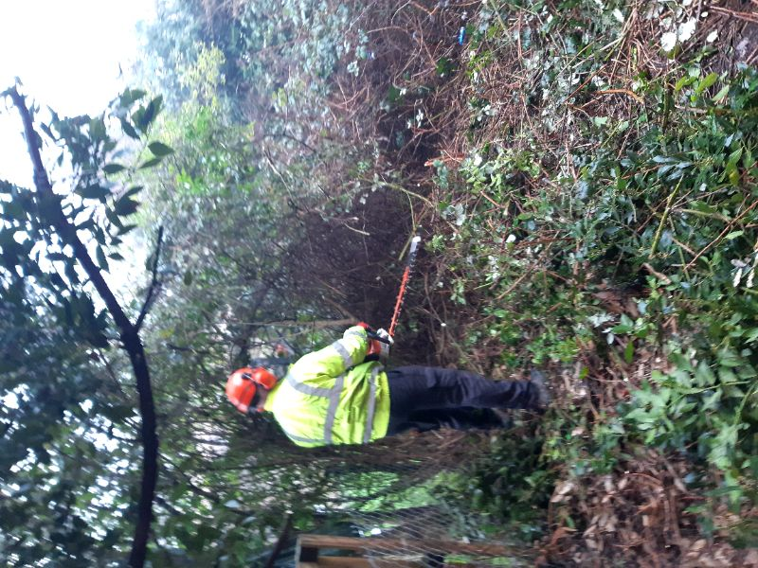
Joyce’s Gardens
Health and wellbeing is a fundamental challenge within the housing community. We have been supporting residents through our volunteering program throughout the pandemic, giving our time to improve the livelihoods of our residents and the community.
Joyce from south London lived alone, and had struggled with the upkeep of her garden due to regular admissions to hospital . This had become a real problem for Joyce and her neighbours. Joyce had not been able to use her garden for many years, with access being so challenging it had become a fire hazard.
Just Ask sent a team to the property, who cut back the overgrown areas, and removed a large amount of waste which was an overspill from Joyce’s house. Staff involved Joyce and her social worker in all the decision making and made sure that she had full support when needed throughout the process.
A2 really wanted to thank you and your team for the hard work and effort completing this clearance given the difficult situation with both lockdowns and ensuring the arrangements were suitable for a vulnerable adult. The team did such a thorough and high quality job, and we really are incredibly impressed with the work.

Slide 7
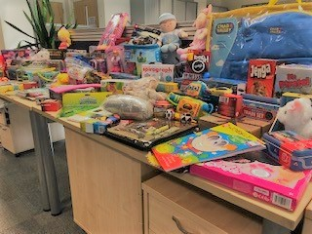
Supporting Demelza House
Over Christmas there were over 600 children with serious or terminal conditions in our communities, all relying on the unique care and support from Demelza. The pandemic had taken away the special Christmas that they were all looking forward to at the hospice this year .
Demelza are committed to making sure children who may not have a long life, are supported to the fullest, giving them the Christmas they deserve.
Our staff supported Demelza this year by collected gifts and toys to be donated in the hope that in very difficult times this will make a small but positive impact.
.

